Slide 1

CSCI 476: Computer Security
Introduction, Syllabus, and Logistics
Reese Pearsall
Fall 2024
https://www.cs.montana.edu/pearsall/classes/fall2024/476/main.html

Slide 2
Before we jump into course rules, we will do a short exercise to get you thinking about security

Slide 3
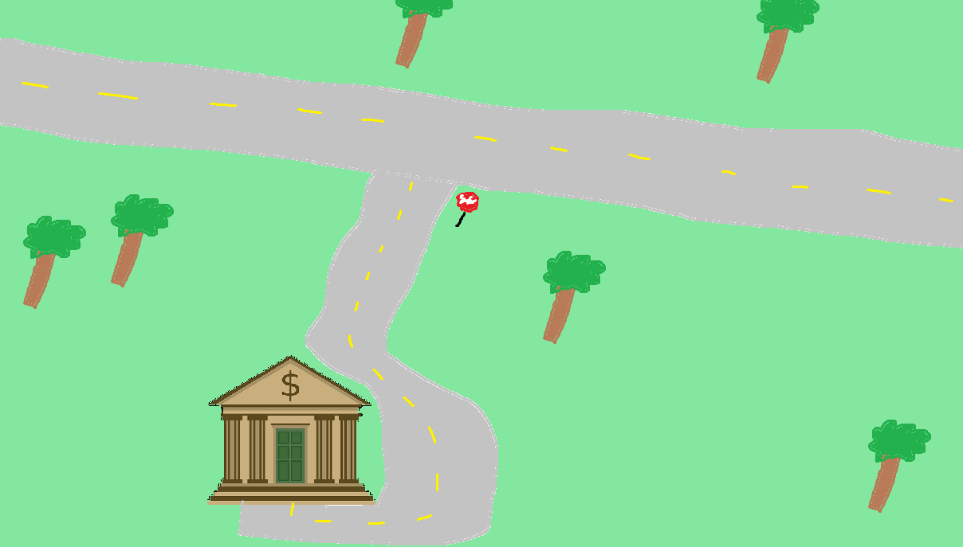


We need to secure the area around the bank
Only people that are allowed should be able to pass into the bank

Slide 4
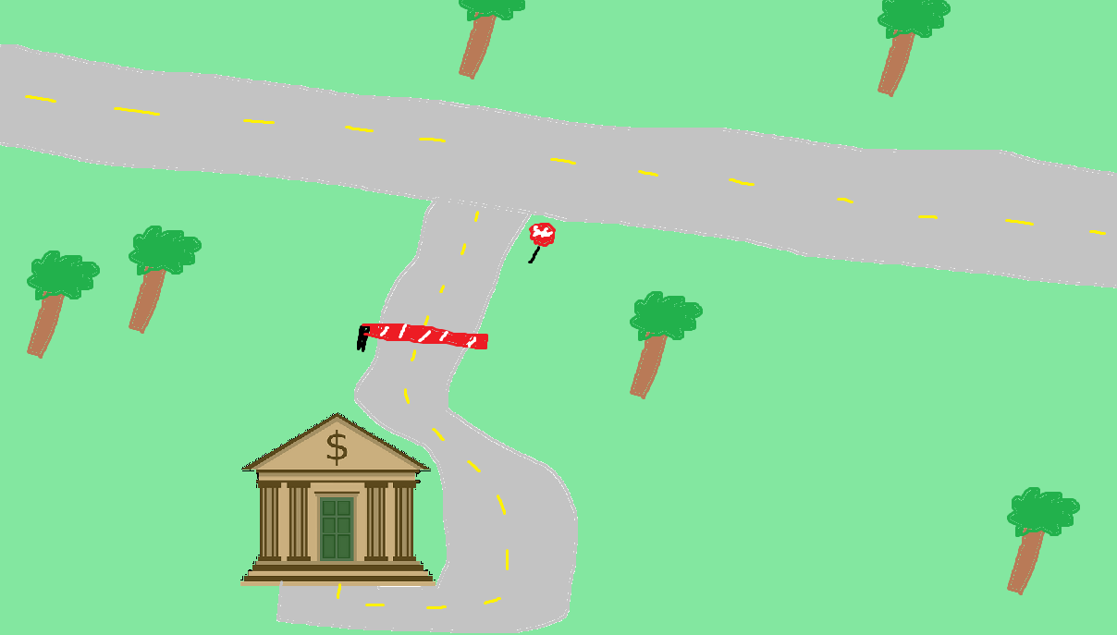
A gate that will block incoming cars

Slide 5
Any problems?

Slide 6


Someone can simply drive around the gate

Slide 7



They don’t even need to use a road!

Slide 8
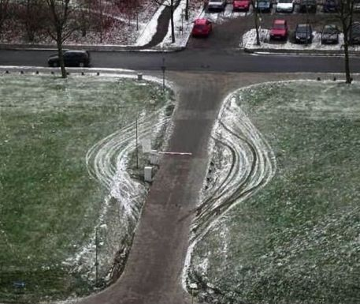



They don’t even need to use a road!

Slide 9
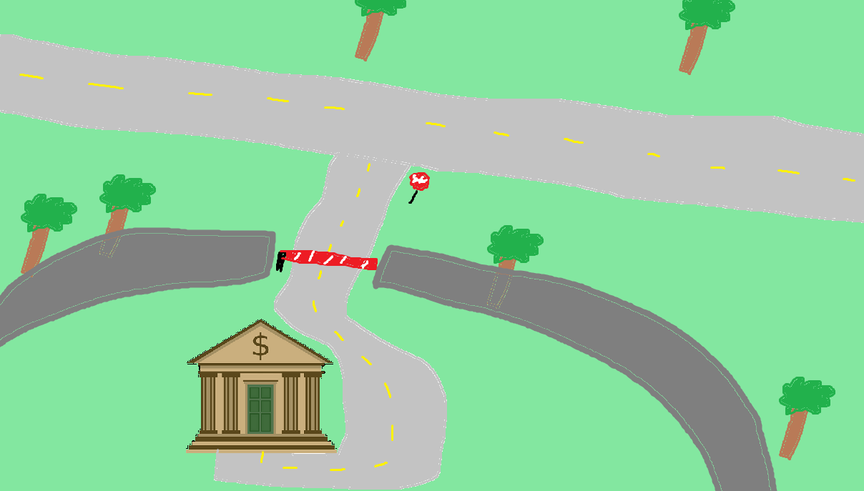
A countermeasure to this would be to build a wall

Slide 10
This is better… but maybe not perfect

Slide 11
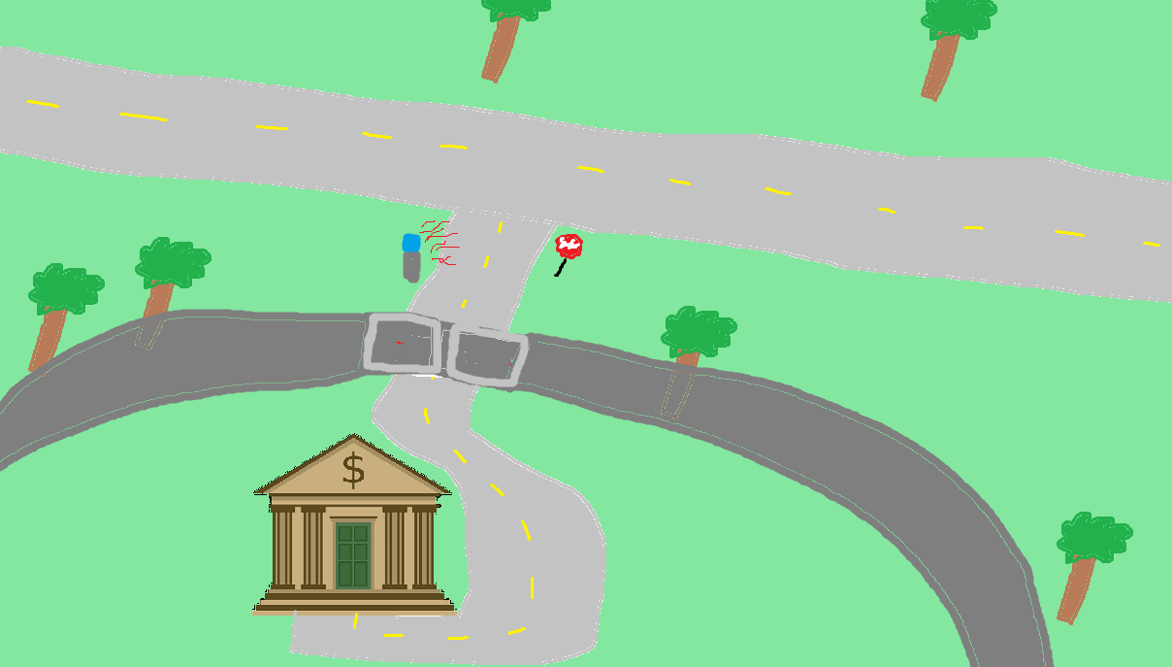
Scanner that will scan ID/license plate and only open the gate for authorized user
This is better…

Slide 12

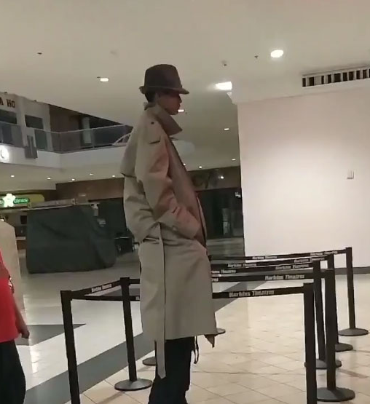
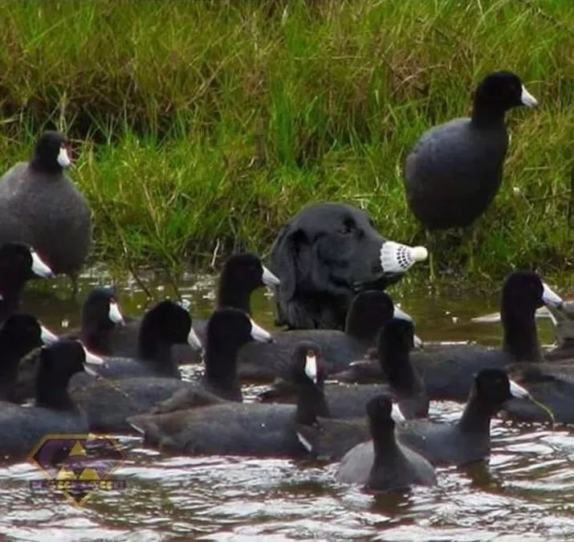

How do we know they are who they say they are?
Who can we trust?
This is better…

Slide 13

We could pretend to be someone else, steal someone else’s ID, or maybe even hack the scanner itself!
This is better…

Slide 14
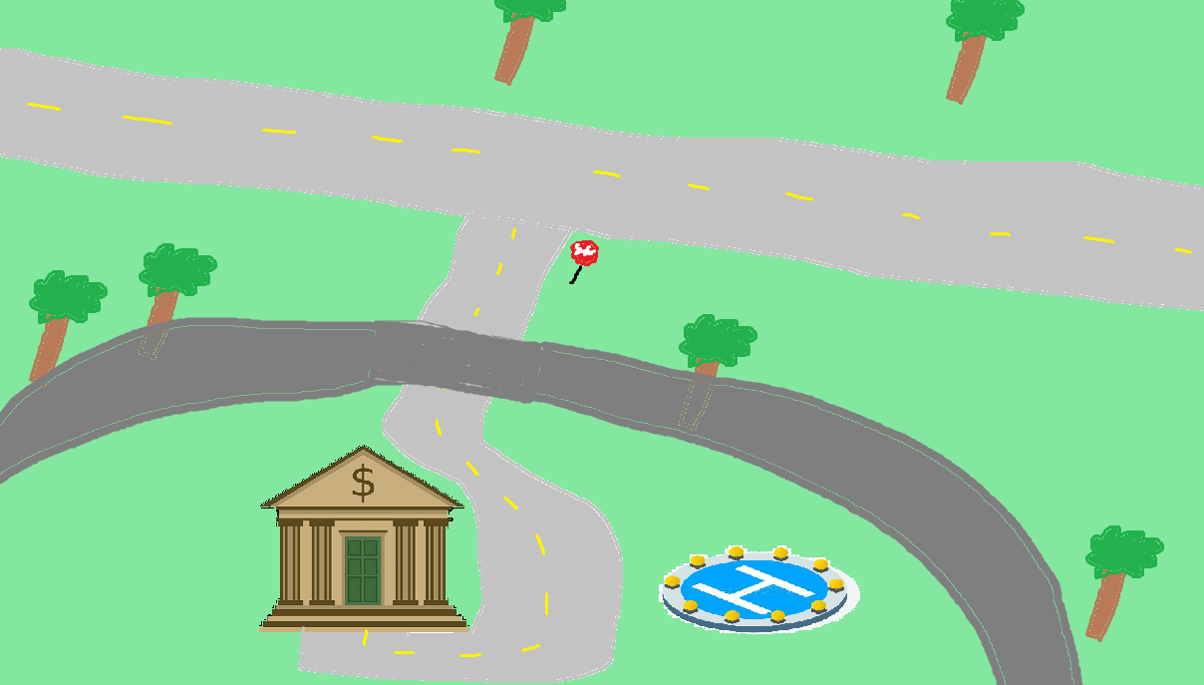
This is better…

Slide 15


Security needs to be accessible and useable
This is better…

Slide 16
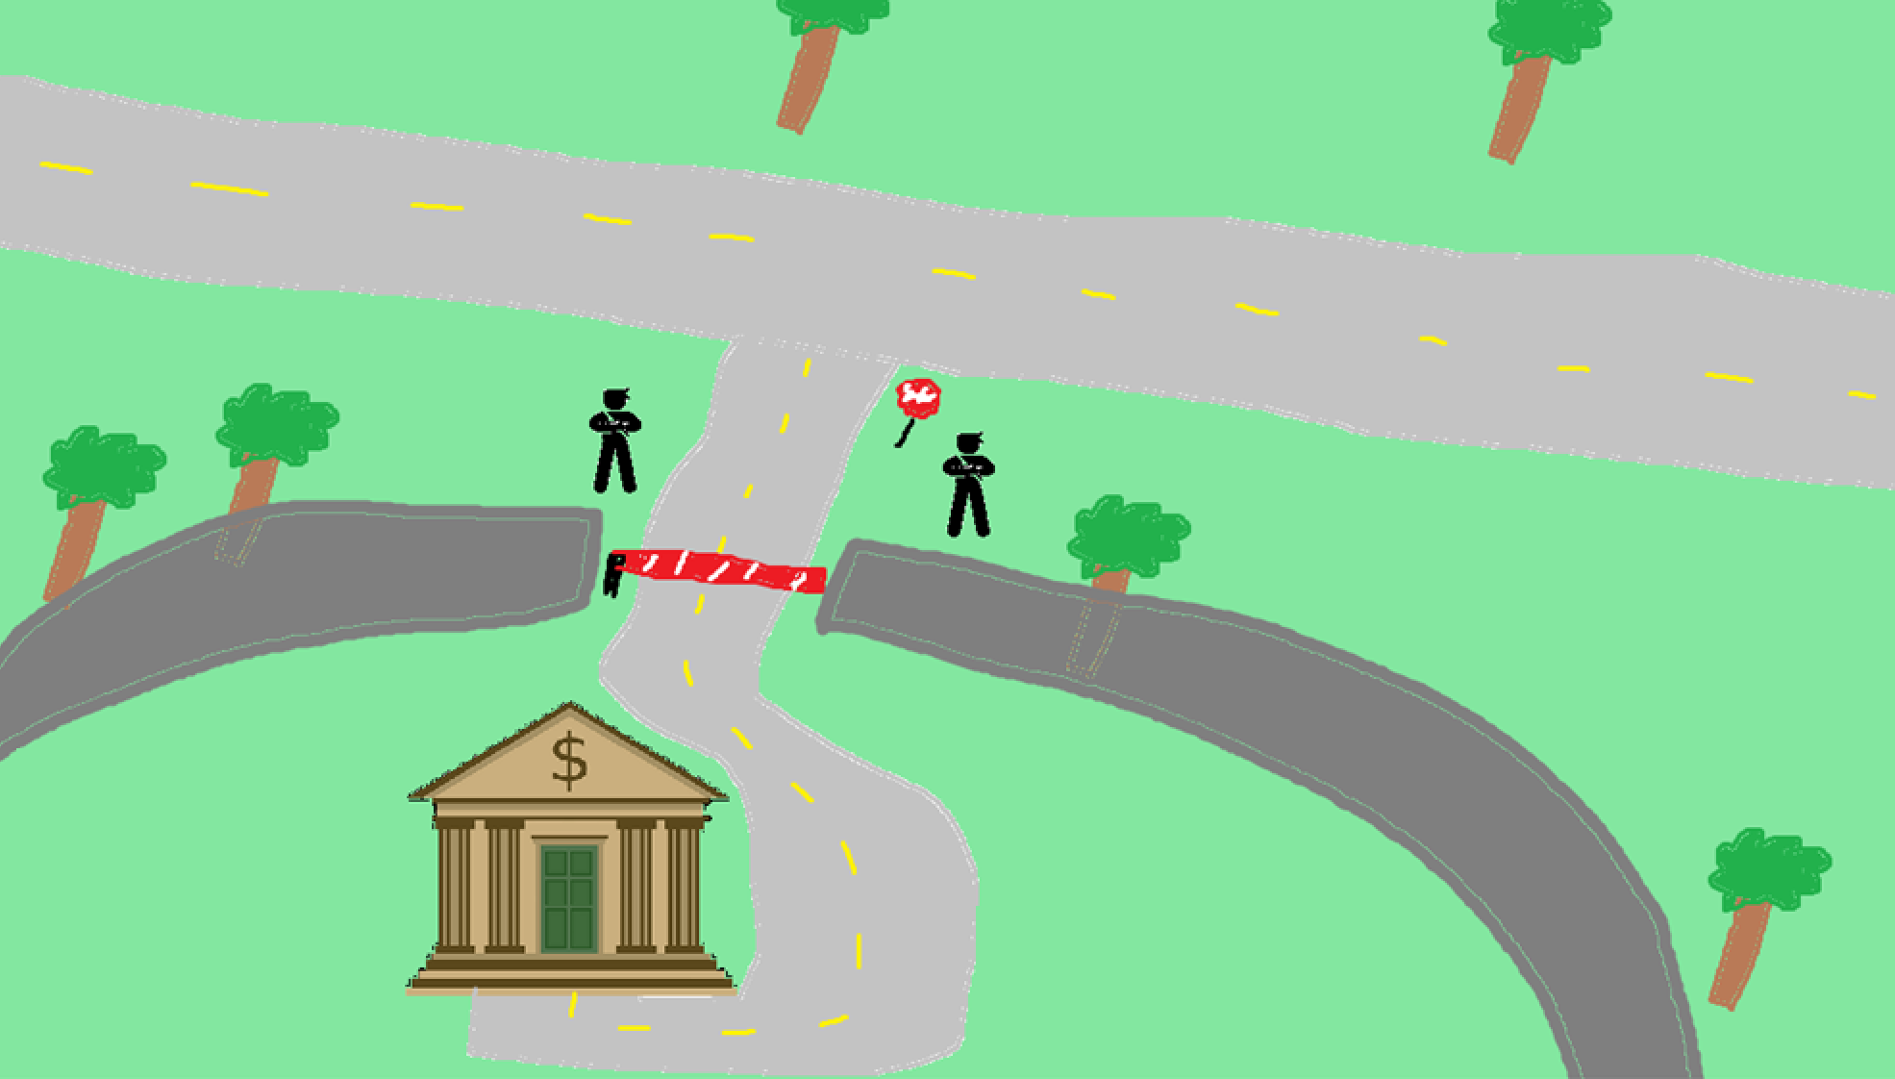
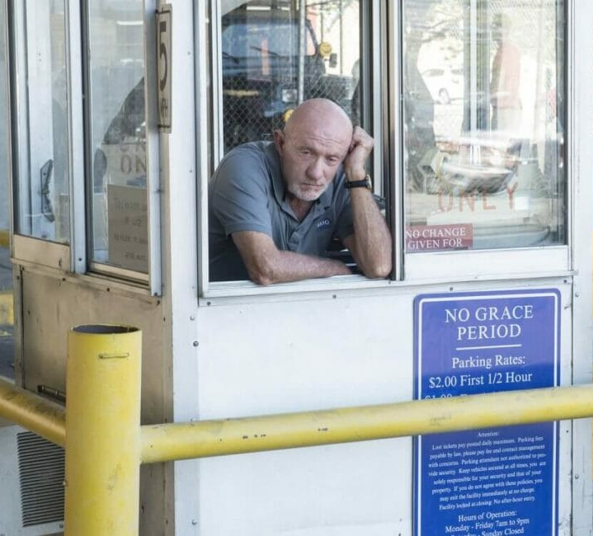
Let’s add some humans to our design!

Slide 17
Consequences of adding humans into our design?

Slide 18

Humans can be manipulated

Slide 19
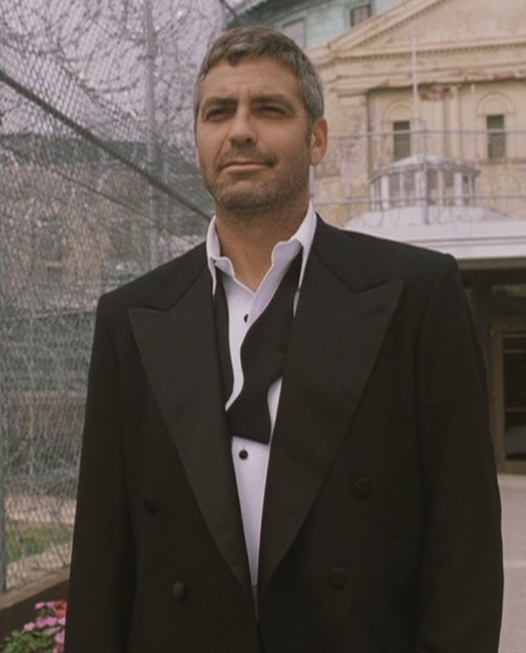
Oftentimes in security, we must consider even the craziest scenarios

Slide 20
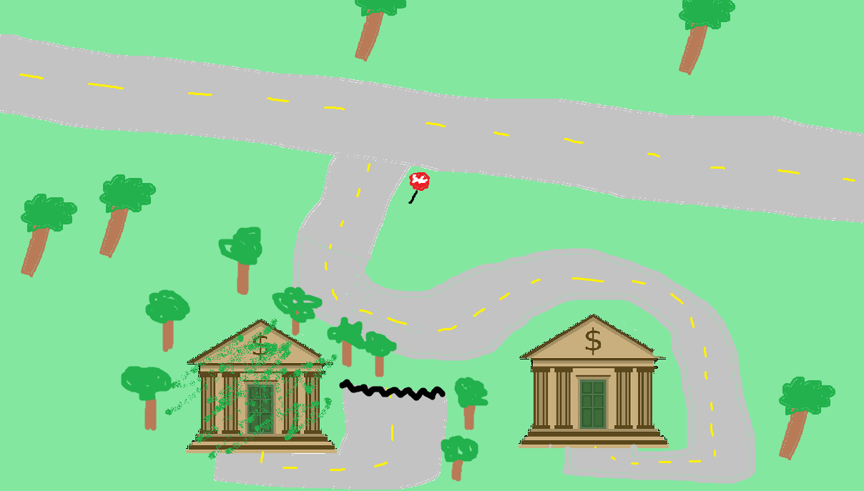



What if someone build an exact replica of the bank and tricks people to go to fake bank instead?
This bank is now controlled by the evil person and can see everything that is happening

Slide 21


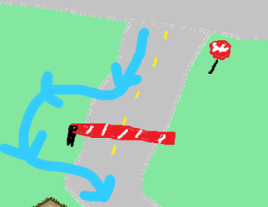
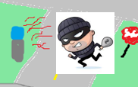



CSCI 476 Common Themes
Authorization and Trust
Intended Design of Software
Unpredictability of Humans
Exploitation of powerful tools and programs
Countermeasures
Misdirection and Hijack of control flow

Slide 22

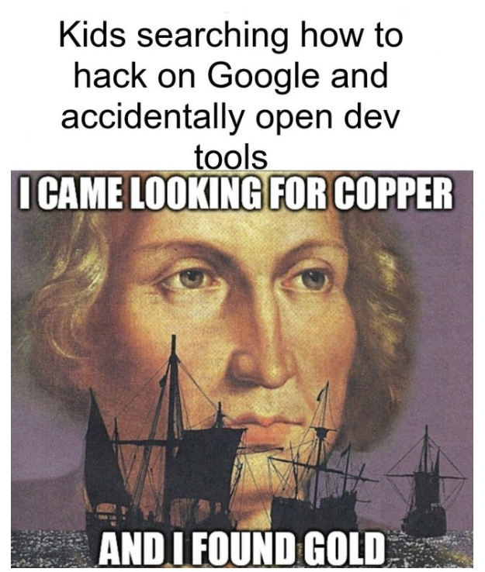
CSCI 476- Course Outcomes
Understand important principles of security and threats to the CIA triad
Understand a variety of relevant vulnerabilities and defenses in software security
Understand a variety of relevant vulnerabilities and defenses in network security
Understand a variety of relevant vulnerabilities and defenses in cryptography
Given a system, develop a threat model, assess potential security weaknesses, and be able to think from the perspective of a threat actor
Make technical decisions during development of software with security in mind

Slide 23

You will learn skills that can be used for good and for evil
You should not use tactics learned in this class on real systems
Use your power for good

Slide 24
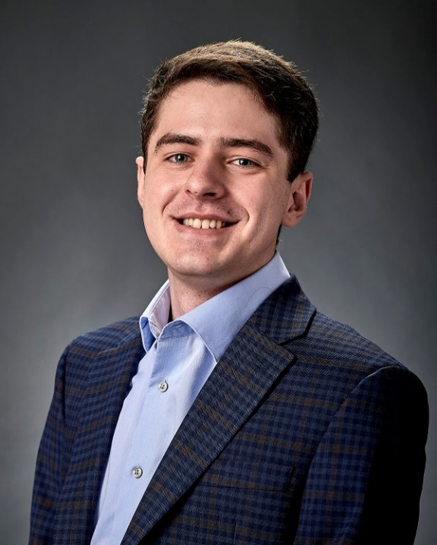
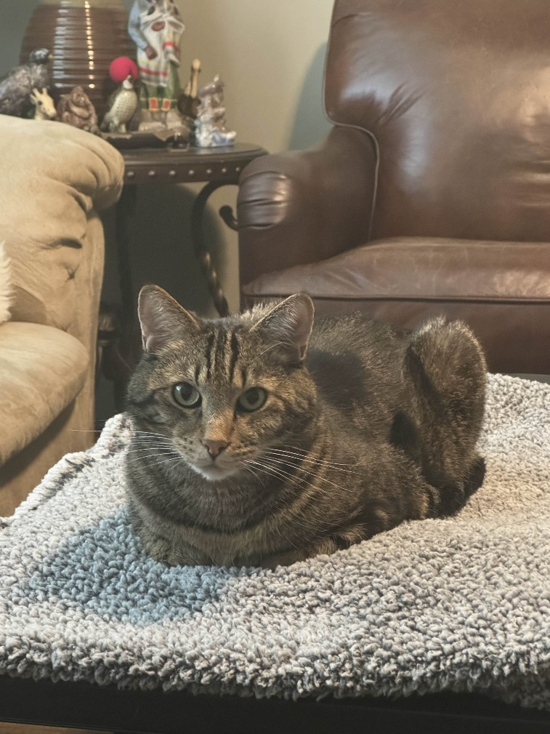



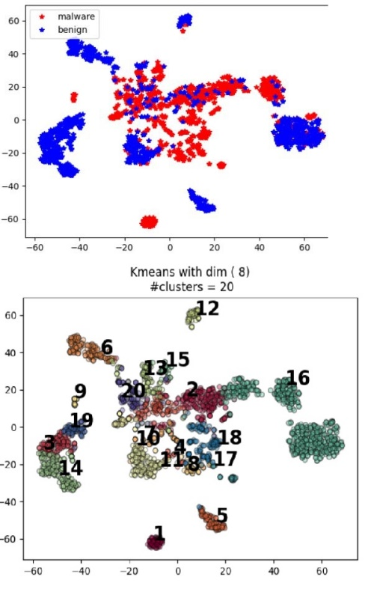
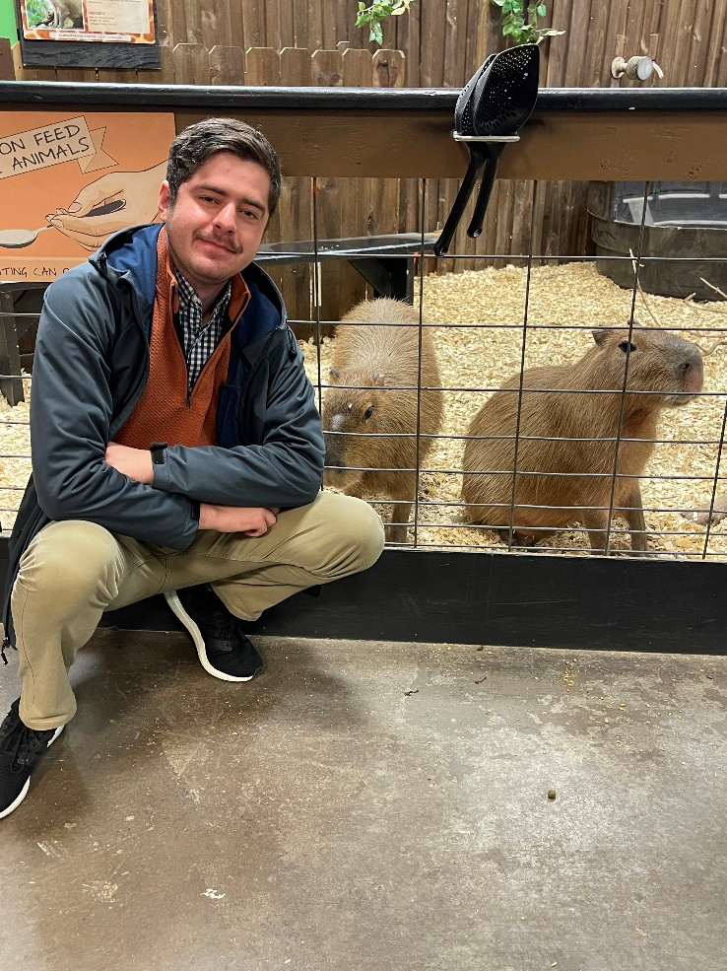
Reese Pearsall
(pierce-all)
Third year Instructor @MSU
B.S & M.S @ MSU
Hometown
Billings, MT
Interests
Cybersecurity
Malware analysis and detection
Cybercrime
Computer Science Education
Meatball
Teaching
CSCI 132
CSCI 466
CSCI 476
Candy of choice
Sweet tart ropes
Experience
Software Engineer and Tester, Techlink (Bozeman)
Software Engineer, United States Air Force (Hill AFB, Utah)
Cybersecurity Software Engineer, Hoplite Industries (Bozeman)
Graduate Researcher, MSU (Bozeman)
Outside of academia
Video games, New England Patriots, Fantasy Football, TikTok, Garfield, Dr Pepper, Memes, The Bachelor, Naps

Slide 25
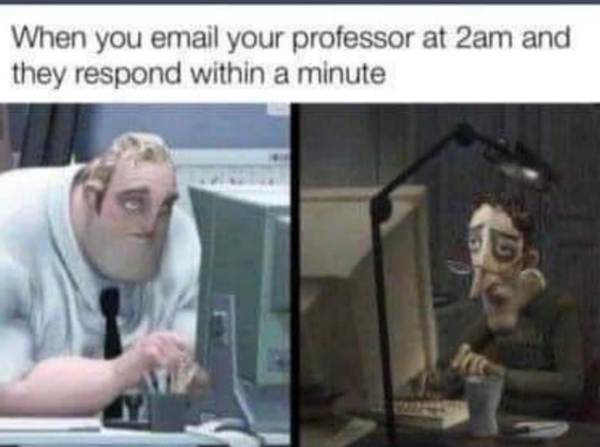
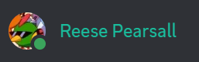
Contact
Email: reese.pearsall@montana.edu (I will respond as soon as I can)
Office Hours: Monday, Wednesday, Thursday, Friday 1:00 PM – 2:00 PM and by appointment
If my door is open, you can always come talk to me
Office: Barnard Hall 361
I am also very responsive on Discord!
(@reese_p)

Slide 26
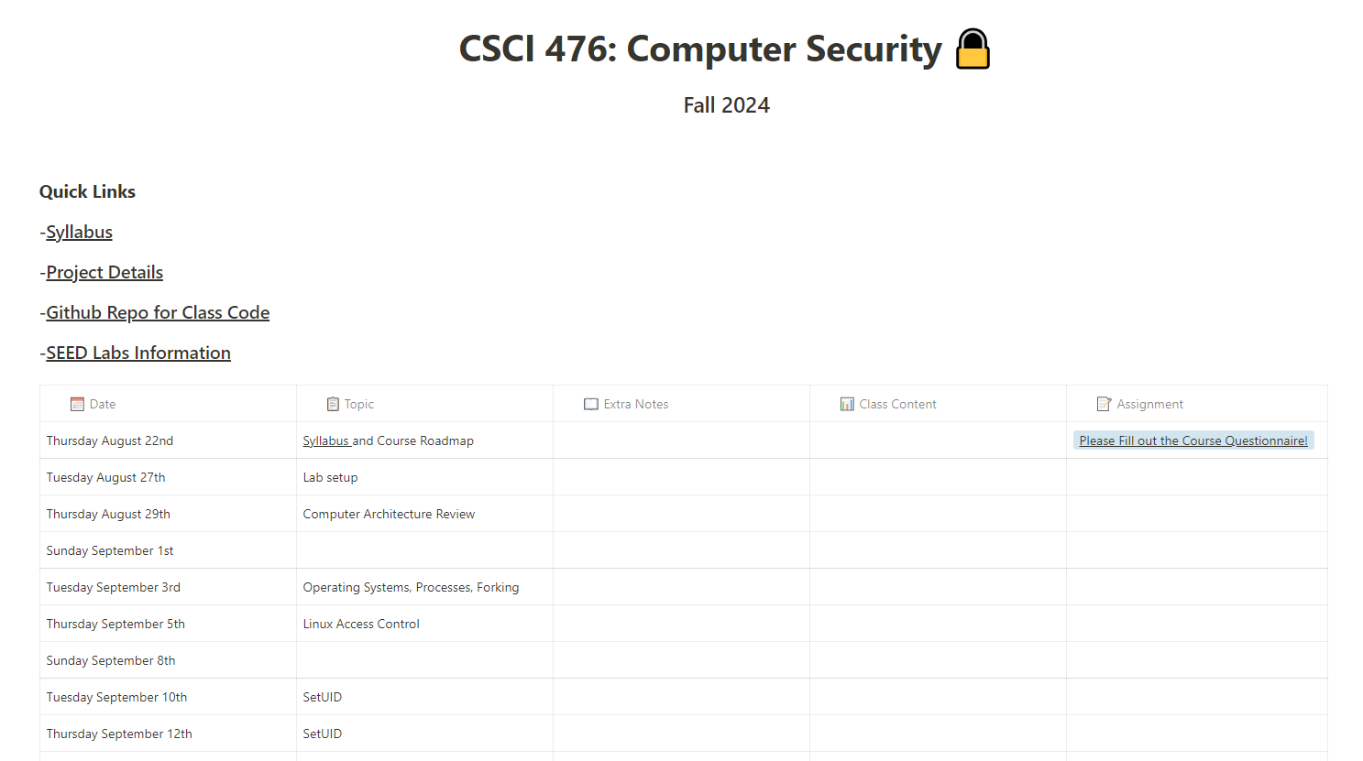


Logistics
Class Meetings
TR: 3:05 PM – 4:20
Romney Hall 315
All lectures will be recorded and put on the website
Course Website: https://www.cs.montana.edu/pearsall/classes/fall2024/476/main.html
We will be using Discord for class communication and for announcements
Get your role and change your nickname!

Slide 27
Prerequisites
CSCI 232- Data Structures and Algorithms
CSCI 460- Operating Systems (recommended)
CSCI 466- Networks (recommended)
CSCI 366- Computer Systems (recommended)
CSCI 112- Programming in C (HIGHLY HIGHLY HIGHLY recommended)

Slide 28
Prerequisites
CSCI 232- Data Structures and Algorithms
CSCI 366- Computer Systems (recommended)
CSCI 112- Programming in C (HIGHLY HIGHLY HIGHLY recommended)
Before taking this class, I expect you to be comfortable with
Basic Python and C programming
Basic Linux command line navigation
Basic computer architecture (Memory, CPU, Assembly, Hex, OS, etc ) we will review this

Slide 29

Schedule

Slide 30
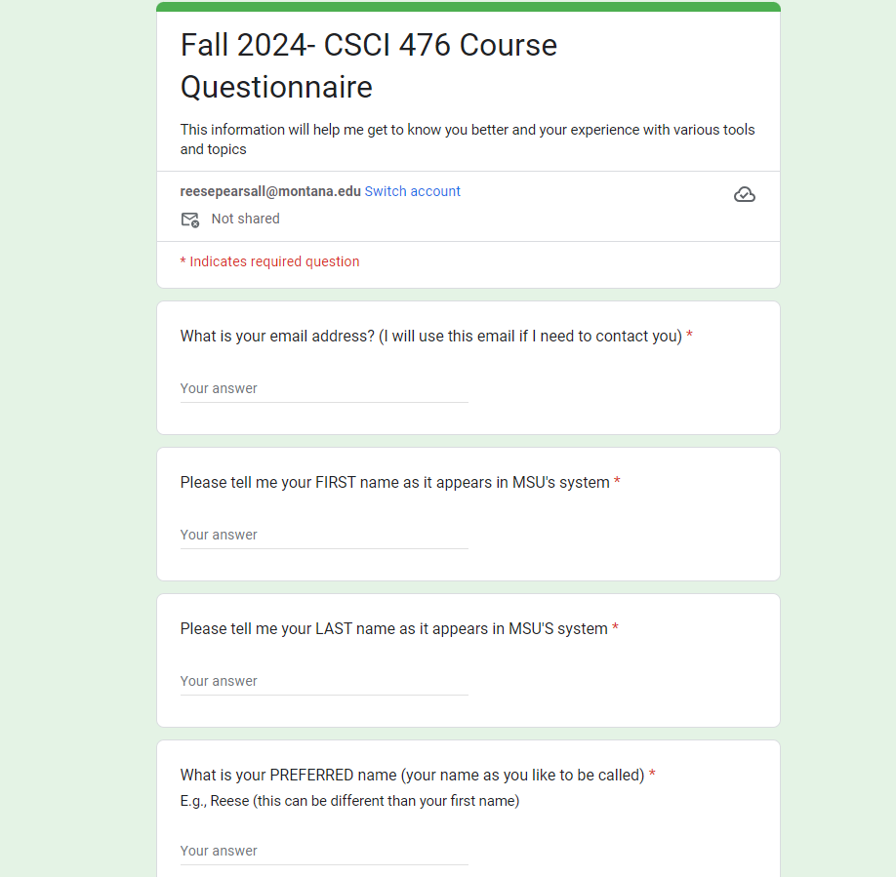
Course Questionnaire
Please take some time to do the course questionnaire today or tomorrow
Your answers are important to me and will help make this class a better experience
Part of your grade for Lab 0 will be for completing the questionnaire

Slide 31
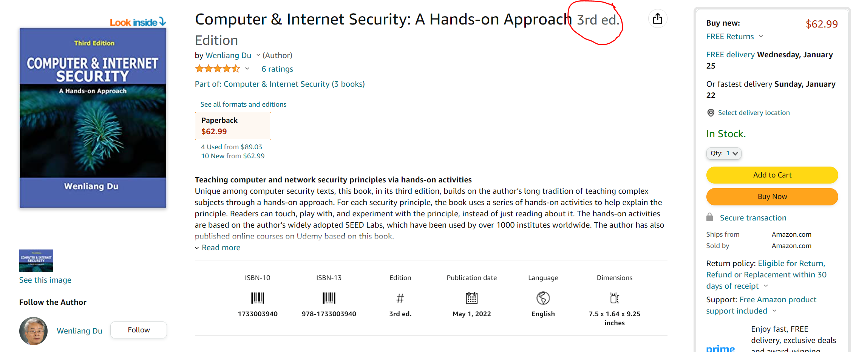
Textbook
I will not require you to get the textbook, but it is a great resource for learning the material and doing the assignments

Slide 32
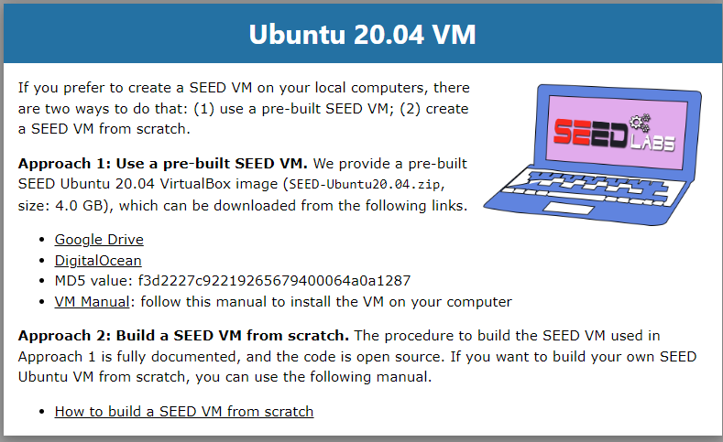
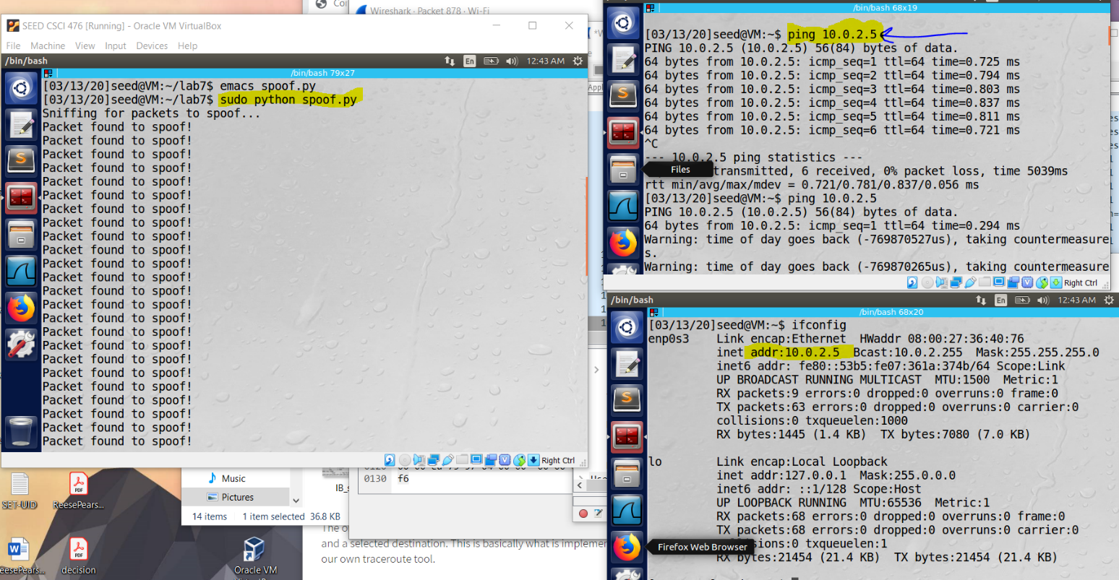
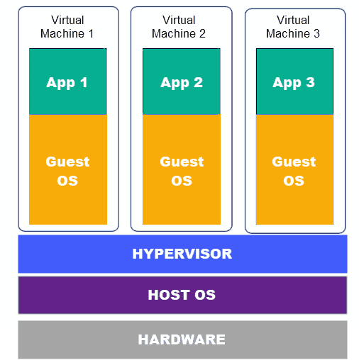

SEED Labs
The majority of work for this class will be done on the SEED Labs virtual machine
On Tuesday we will walk through the installation process together
It will be helpful if you download this file before class on Tuesday.

Slide 33
Grading
70% Labs (10)
15% Research Project
15% Final Exam

Slide 34
Grading
70% Labs (10)
Learn by doing, which will enhance your understanding of computer security
We will use the VM to replicate the attacks we discuss in lecture
Follow the instructions, and record your observations and output
Submitted to Brightspace as a PDF

Slide 35
Grading
15% Research Project
You will explore a cybersecurity-related topic of your choice (one we did not discuss in class)
You will have a choice of writing a paper or creating a video presentation on the topic
You can submit it at any point in the semester, but deadline is November 21st
You must get your topic approved by Reese first

Slide 36
Grading
15% Final Exam
Cumulative exam that covers content from the entire semester
Exam consists of short answer questions
Will take place during finals week (in-person)
You get to use a note sheet

Slide 37
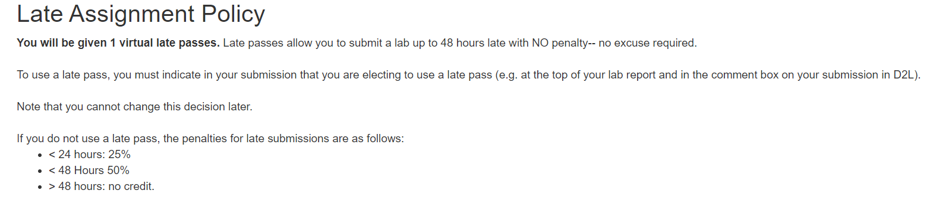
Late Assignment Policy

Slide 38
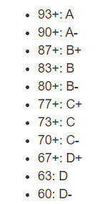
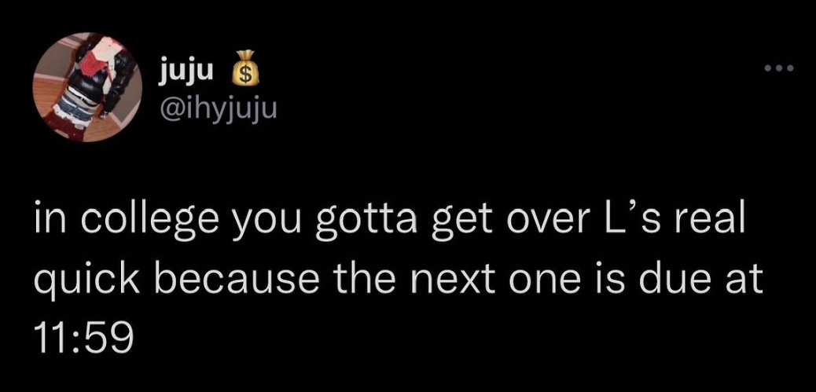
Grading Scale
At the end of the semester, if you are within 1% of the next letter grade, I will bump you up
I will not curve exams or final grades unless it is needed

Slide 39
Plagiarism, Academic Misconduct, Generative AI tools
Plagiarism and cheating is very not cool
You are not allowed to submit something that is not your own, and you are not allowed to steal solutions from another person and modify it
I have a Chegg and Course Hero membership. Don’t try it
Using small snippets of code from the internet is acceptable (but should not be needed). If you do use a small snippet of code from the internet, you should leave a reference as a comment in your code
Do not use any tools or AI that will write code or solutions for you

Slide 40
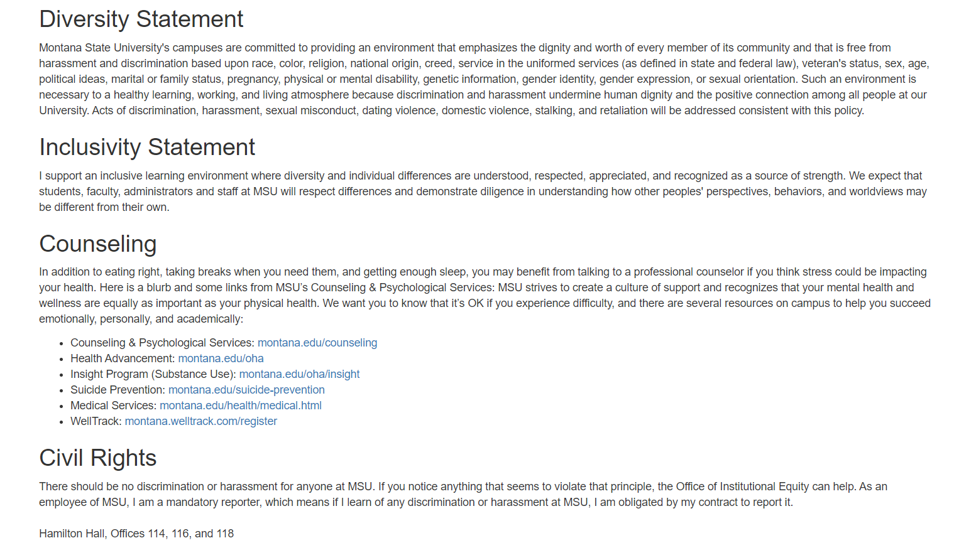
MSU Resources
https://www.cs.montana.edu/pearsall/classes/msu_resources.html

Slide 41
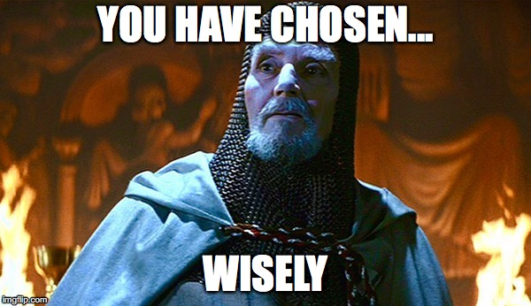
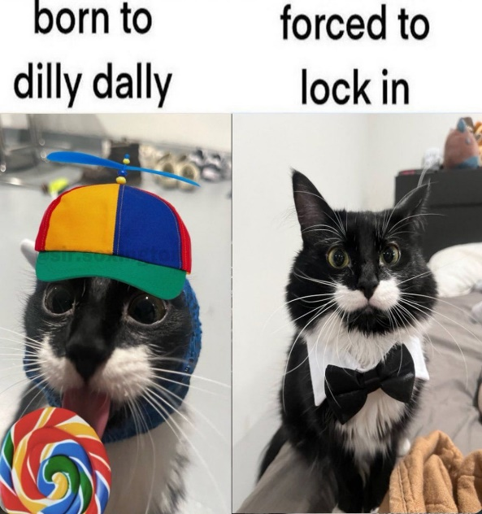

How to do well in this class
Get started on labs early
Get help when you need it
Come to class and office hours]
Take care of yourself
Try to have fun

Slide 42
Questions?

